Slide 1
Controller in 'REFILLED' State Investigation
NOC: PRB-82

Slide 2
Issue Definition
What We Know
Analyze
Recommendations

Slide 3
Issue Definition
Agents have reported to NOC the ‘Hardware Error’ received on the KP screen when a customer tries to dispense fuel into a canister.
Agents also report that the error occurs after a refill procedure on the KP is completed, and the refill team leaves.
NOC report that the error occurs because the KP controller is in a ‘REFILLED’ state, but the screen returns to its idle state (playing ads). Remotely restarting the KP results in a change of the controller state to IDLE, thus customers are able to use the KP.

Slide 4
Issue Definition
This issue affects the customers trying to dispense on an affected KP. They have to wait for a remote restart to be initiated by NOC so that they can buy fuel.
The objective of this investigation is to reduce/eliminate the occurrences of this issue

Slide 5
What We Know
37 incidents of the ‘Controller in REFILLED state’ issue have been recorded from the start of March 2020 up to date, all of which were resolved by remotely restarting the affected KP
23 different KPs have been affected by this issue, with KP-0130 having the most occurrences (6)
Out of the 23 KPs, 17 have experienced the ‘REFILL_DOOR_OPEN’ issue separately, afterwards.
Out of these 17, KP-0753 and KP-0021 have the most occurrences of the ‘REFILL_DOOR_OPEN’ issue (3), followed by KP-0130, 0053, 0094, 0206 and 0426 with two occurrences

Slide 6
What We Know
This points to a direct relation between KPs that experience the ‘Controller in REFILLED state’ and ‘REFILL_DOOR_OPEN’ issue, necessitating the need to investigate findings from the maintenance team on checking the ‘REFILL_DOOR_OPEN’ causes.
79 incidents of the ‘REFILL_DOOR_OPEN’ issue have been recorded from the start of January 2020 up to date
58 different KPs have been affected by this issue, with KP-0286 having the most occurrences (4), followed by KP-0753 & KP-0021 with 3 occurrences
The graph on the next slide summarizes the findings on the REFILL_DOOR_OPEN issue

Slide 7
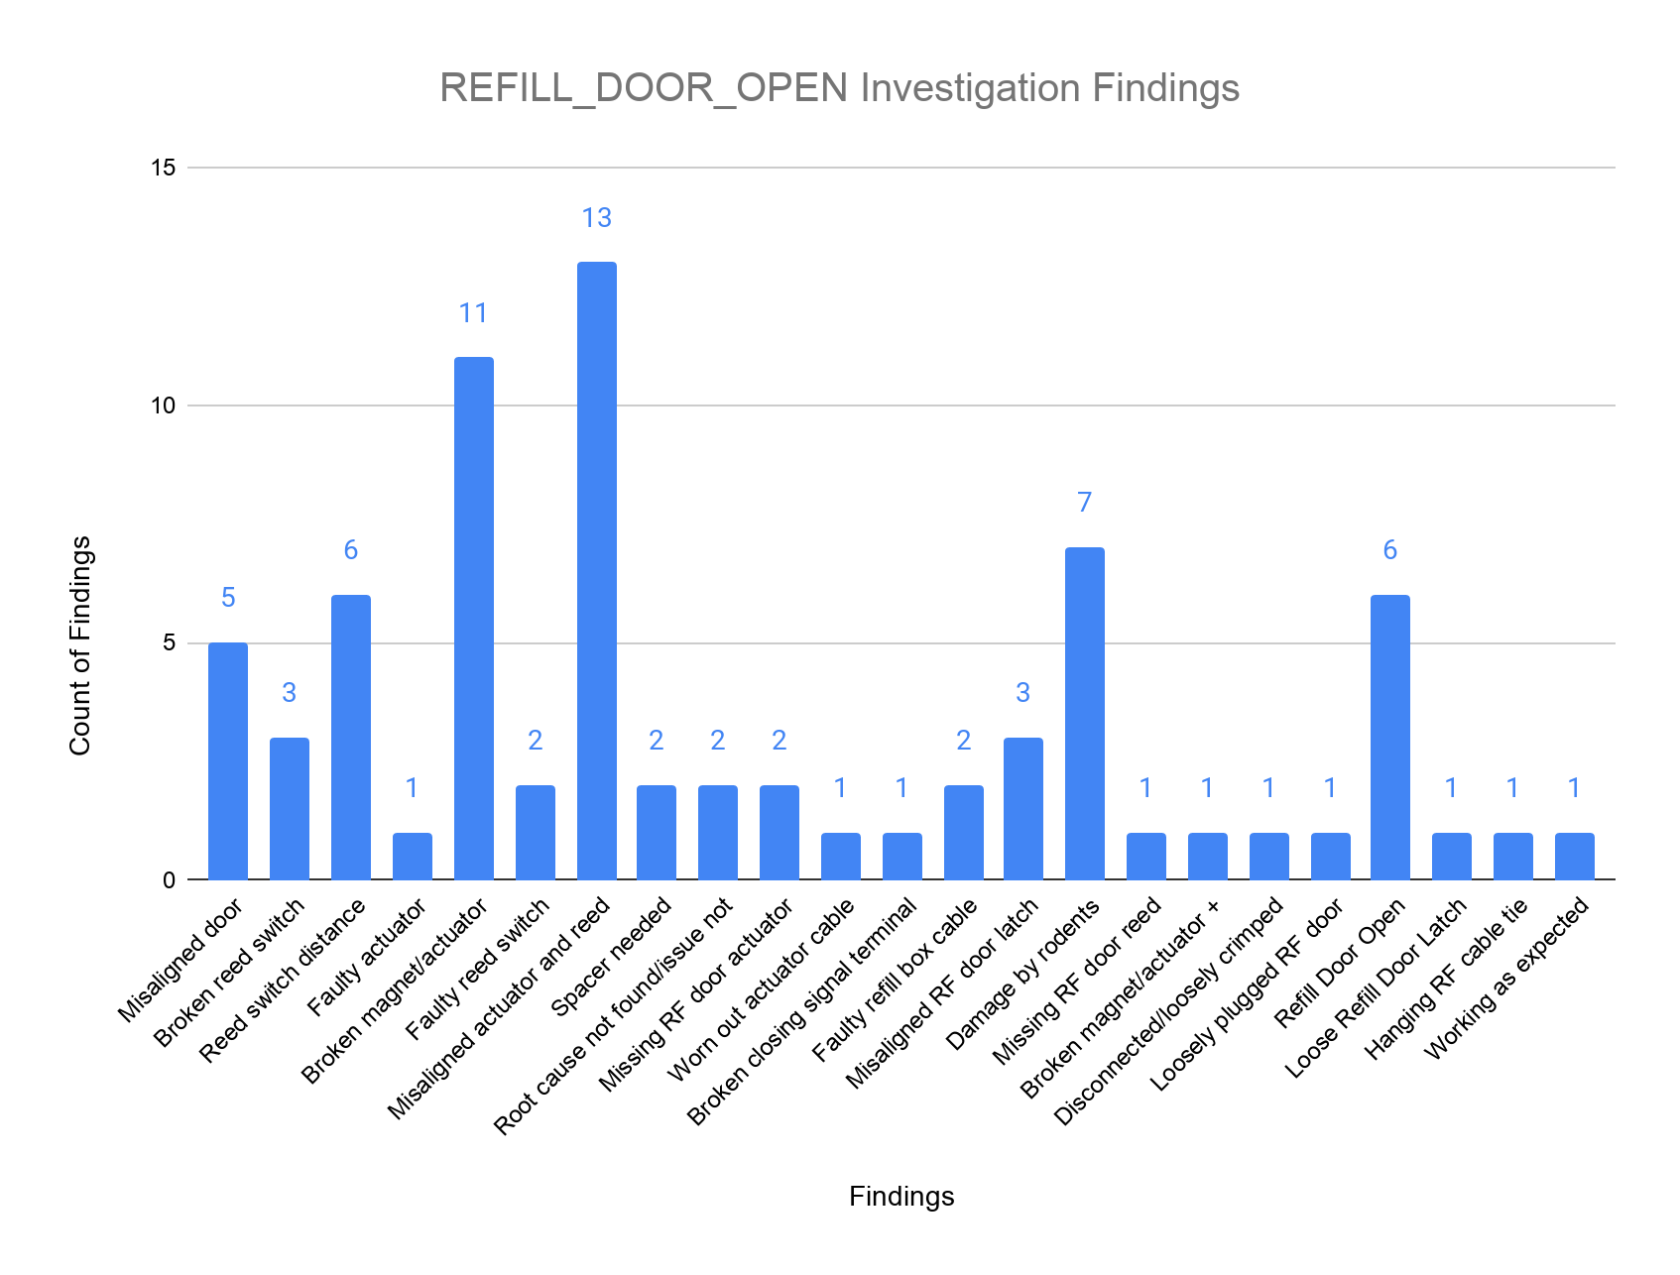
What We Know

Slide 8
What We Know
The following is a summary of the most common findings:
Broken magnet/actuator/reed switch - 14
Misaligned actuator & reed switch - 13
Misaligned door/door latch - 8
Damage by rodents - 7
Reed switch distance - 6
Refill door open - 6

Slide 9

Analysis
KP Logs Analysis
Possible root cause(s)
Solution(s)

Slide 10
KP Logs Analysis
Logs of 4 affected KPs were analyzed (KP-0021, KP-0207, KP-0345, KP-0753), specifically at the time there was an issue completing their refill, with the following common observations made:
After closing safety valves, CTR state changes from REFILLING to REFILLED & KP stays in that state
State does not change to IDLE even when refill door is supposedly closed (after refill team leave the KP)
Only KP restart changes state from REFILLED to IDLE
Troubleshooting steps from refill team do not solve issue (sometimes make it worse e.g. reopening valves after KP restart)
This points to hardware issues as the root cause

Slide 11
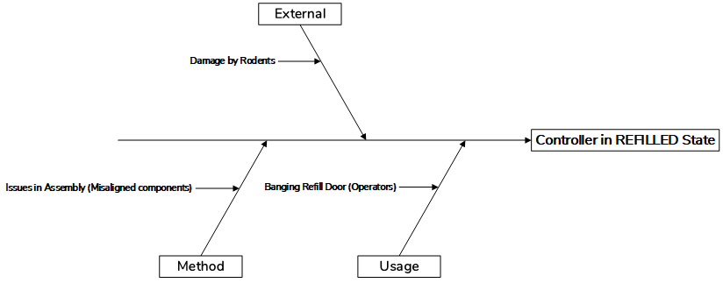
Possible Root Cause(s): Fishbone Diagram

Slide 12
Possible Root Cause(s)
Banging refill box door: Causes breakage of actuators/magnets/reed switches; increases reed switch distance
Damage by rodents: Rodents chewing on refill box cable disables the door sensor thus causing hardware malfunction
Assembly issues: Misaligned refill door/door latch results to refill door not closing fully or actuating completely

Slide 13
Recommendations
Retraining of refill operators on:
Proper opening & closing of refill door
Proper troubleshooting & reporting steps to be taken when issue is encountered
Close up refill hoses opening behind refill box, with a refill box rodent grommet, preventing rodents from entering refill box
Introduce ‘CLOSE REFILL BOX’ screen to refill procedure, once refill is complete and valves are closed, providing visibility on whether refill door is closed or not
Revise refill box design for next KP version

